Slide 1

Getting it to the market
Complying to the urgency of a sustainable construction economy
7th International Slag Valorisation Symposium
27-4-2021
Boudewijn M. Piscaer
Pantheon Performance Foundation
NEXT GENERATION CONCRETE

Slide 2
Motivations
All people like to be associated with success.
While educators are mostly scientists, students have often other careers in mind.
Involvement of big metal industry besides classic Portland cement industry is refreshing.
CO2 reduction is urgent and geopolymers with metal slags are a proven part of the solution.
Science-Technology- Practice communication an opportunity.

Slide 3
Concrete science has high PhD/M3 but poor links with technology and practice

Slide 4
Different cultures in R & D
Fundamental ACADEMIC Research has standard conclusion; “more Research is N€€D€D”.
Academic for INDUSTRIAL applied purpose;
How to manoeuvre with scientific independency?
Need for interdisciplinary approach; Too many academic silo’s, not enough mixers, mix-masters and.
INDUSTRIAL; fast return on investment is needed but key question: will knowledge be shared in order to accelerate market acceptancy and supply chain?
Are TRL (Technological Readyness levels) in sink with MRL (Market Reconnaissance Levels)?

Slide 5
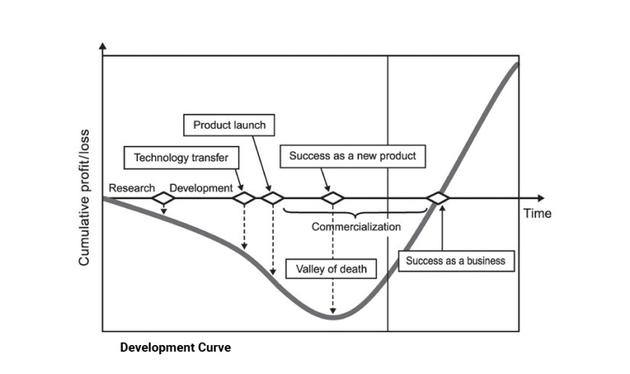
Classic innovation valley of death

Slide 6
Sharing knowledge ≠ sharing success!
DATA | Is not | Info is not | Knowledge is not | Understanding is not
DATA
WISDOM
other organization?
market reactivity,
credibility, suppliers
UNDERSTANDING
New Technology
+
Old Organization
= Expensive
Old Organisation
KNOWLEDGE
Attention to skills & practice
INFORMATION
Damage control
Liquidation management

Slide 7
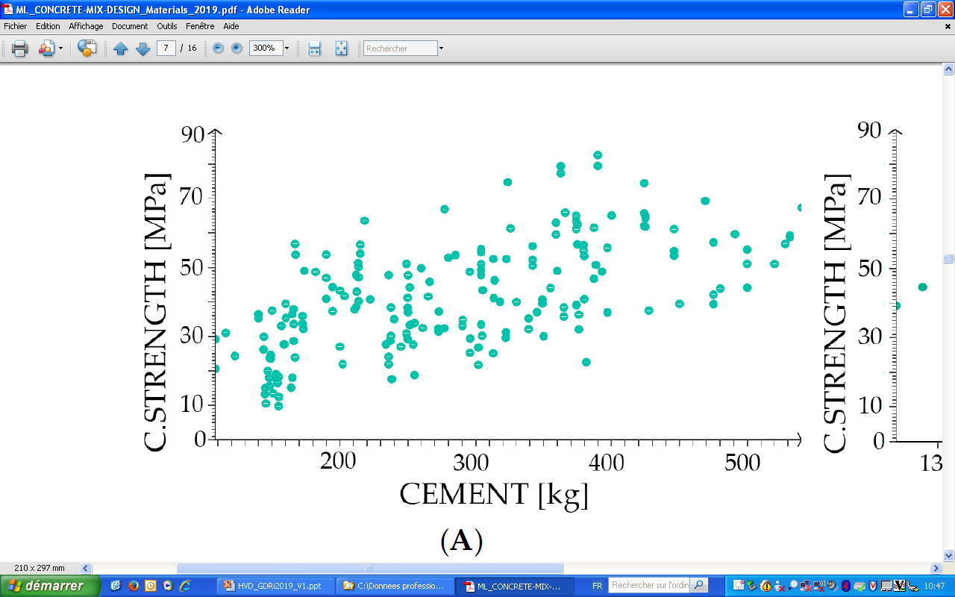
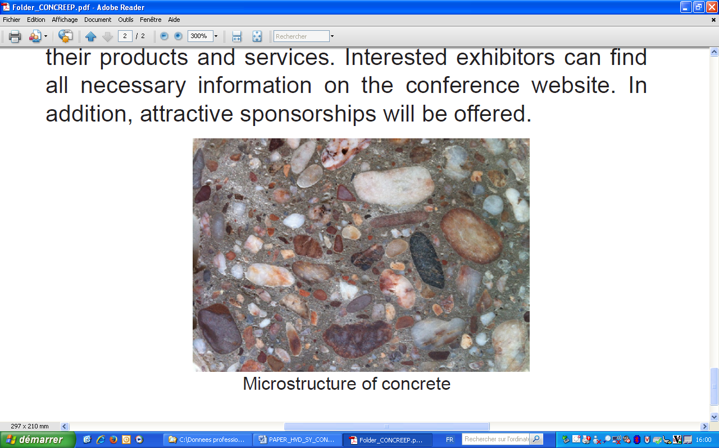
Dramatic proof that
concrete knowledge transfer failed
P. Ziolkowski, M. Niedostatkiewicz, Machine Learning Techniques in Concrete Mix Design, Materials, 12, 1256 (2019)
Every idiot can make concrete. The problem is, they do! A. Neville
Q. What suppliers want to keep it that way? B. Piscaer

Slide 8
27 versions of EN 206 for concrete
I. Water Binder Ratio ( Self Compacting C 56/65 precast ) 180 kg Cem I, 180 kg GGBS, 180 kg Ground pure limestone.
UK 0.40, DE 0.92, “Equal rights” concrete WBR 0.36
Water Binder Ratio is NOT performance technology but prescriptive market driven and environmental unfriendly pseudo technology.
Process control at 20º C and 28 day curing (Lab-Crete) instead of needed Quality Assurance of “Real-Crete”!
Q 1. Is the steel content of a car essential for performance?
Q 2. In what would we drive if the steel industry would have developed the car?

Slide 9
Present sub-supplier driven concrete economy
Cement & Aggregate influence
- STANDARDS
EN 197, 206 etc.
- LOBBY
Cembureau, ECTP, Brussels
WBCSD Geneva.
Global Cement & Concrete Association, London
- SPONSORING
Universities
Concrete societies, events, etc.
Present “Value” chain
CLI€NT
Architect
STRUCTURAL engineer
CONTRACTOR
Subcontractor (installations)
SUPPLIERS
Concrete producers; Prefab & Ready mix
Sub-suppliers; Cement & Aggregate producers etc.

Slide 10
Sustainable construction Ecosystem
Societal & CLI€NT driven
Information
& lobbies on wood,
concrete
steel etc.
Infuencers
DESIGNERS
Architect,
CONSULTING
Structural,
Sustainability &
Material Engineering
Authorities
Quality assurance etc.
SUPPLIERS, contractors
producers, sub-suppliers
Knowledge transfer, EDUCATION, Science

Slide 11
Proven opportunities for Alkali Activated/Geopolymer Minerals
“Monotheistic” Portland cement religion is now finished, thanks to the CO2 reductions.
Model/Eurocode “Consequence Classes” 0 & 1 provide more than enough applications to prove durability for higher CC 2 & 3.
VERIFICATION methodology, applied at Prorail NL. underpass to include BSI PAS 8820, should give clients confidence.

Slide 12


Paris 26 November 2007 – European Forum on Eco-Innovation
12
The positioning of Verification
Compliance to standards, (EN 197 27 years, EN 206, 20 years, non harmonized)
No need for certification, but need for credible
PERFORMANCE DATA
Certification
Early research
R&D
VERIFICATION
Available in the Market
Prototypes, Demonstration
Self Declarations
No standards exist

Slide 13
Metal industry’s opportunities for “mineral composites” * market
* Preferred name for high tech mortars, concrete, screeds,
Concrete market is facing a new demanding customer for real; civil society going green!
Dominating Portland cement supplier is little interested in cement reduction, reducing capacity, sustainable knowledge transfer and updating standards
Integrated steel makers are familiar with demanding (automobile) customer imposing process changes since 50th and blast furnace slag supplier tradition.
Successful start ups from “Slag Valorization Tribe”

Slide 14
Active commitment of metal producers in construction market
Keep investing in Research, Development, Marketing.
Claim slag valorisation in environmental performance of your basic metal product.
Join material testing organizations such as RILEM,
Consider modifying your slag to suit application in mineral composites market.
Consider joint ventures and involvement in start-ups.
Stay in touch regarding possible GLOBE Pantheon Platform innovation implementation accelerator.

Slide 15







In the pipeline ?
GLOBE consensus; see https://www.rilem.net/article/globe-global-consensus-on-sustainability-in-the-built-environment-192
Pantheon Performance Foundation;
- Accelerate Sustainable Construction Materials
Application Events”.
- Manual of sustainable materials for carbon neutral constructions
Stay in touch regarding a possible GLOBE Pantheon Platform as innovation implementation accelerator. Thanks for your attention www.sustcon.org

Slide 16
Thank you for
your attention!
www.sustcon.org

